Slide 1
Data!
Organizing, Visualizing, & Sampling

Slide 2
Variable Measurement Scales
Nominal: Labels, unordered
Ex: Major (Engineering, Art, History, Economics)
Ordinal: Labels, ordered
Ex: Rank: (1st, 2nd, 3rd)
Interval: Numerical data with equal intervals between values but no zero point
Ex: IQ (75, 90, 103, 138)
Ratio: Numerical data with equal intervals and a zero point
Ex: Incomes ($0, $20, $50k)

Slide 3
Types of Data: Categorical / Qualitative
Labels / Categories
Nominal if labels have no order / ranking
Examples: Major, gender, nationality, political party, hair color
Ordinal if labels have order / ranking
Examples : Grades (A, B, C…), Place (1st, 2nd, 3rd…), Education level (High School, Undergrad, Graduate), Scales 1-10*
Can have numeric labels, but they are still labels, not quantitative data upon which math can be done - 2nd place isn’t 5x better than 10th - INTERVALS MAY NOT BE EQUAL

Slide 4
Organizing One Categorical Variable
Summary Table: A table tallying frequencies or percentages
Used for a single categorical variable
Favorite Class | Total / Frequency | Percentage
Applied Business Statistics | 25 | 83.33%
Managerial Economics | 5 | 16.66%
Poetry | 0 | 0%
Total | 30 | 100%

Slide 5
Organizing Two Categorical Variables
Contingency Table: A table showing the joint frequencies / percentages of two variables
 | Sedan | Truck | SUV | Total
Red | 2 | 1 | 4 | 7
Black | 3 | 2 | 4 | 9
Blue | 4 | 3 | 4 | 11
Total | 9 | 6 | 12 | 27

Slide 6
Organizing Two Categorical Variables
Contingency Table: A table showing the joint frequencies / percentages of two variables
 | Sedan | Truck | SUV | Total
Red | 2/27 = 7.4% | 1/27 = 3.7% | 4/27 = 14.8% | 7/27 = 25.9%
Black | 3/27 = 11.1% | 2/27 = 7.4% | 4/27 = 14.8% | 9/27 = 33.3%
Blue | 4/27 = 14.8% | 3/27 = 11.1% | 4/27 = 14.8% | 11/27 = 40.7%
Total | 9/27 = 33.3% | 6/27 = 22.2% | 12/27 = 44.4% | 27/27 = 100%

Slide 7
Organizing Two Categorical Variables
Contingency tables using percentages can be based on overall totals, row totals, or column totals based on need
 | Sedan | Truck | SUV | Total
Red | 29% | 14% | 57% | 100%
Black | 33% | 22% | 44% | 100%
Blue | 36% | 27% | 36% | 100%
Total | 33% | 22% | 44% | 100%

Slide 8
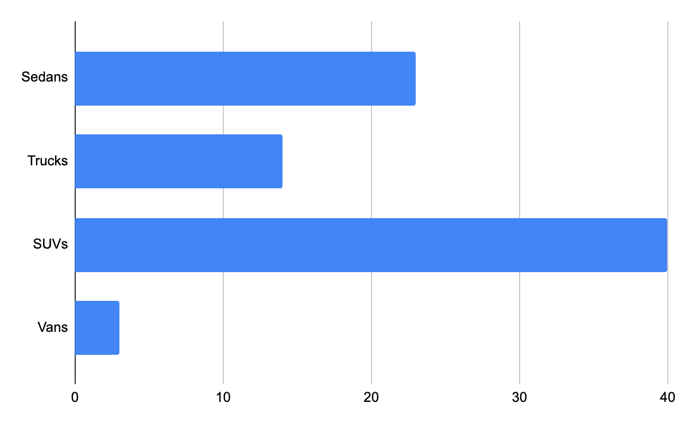
Visualizing Categorical Data: Bar Charts
Sedans | 23
Trucks | 14
SUVs | 40
Vans | 3

Slide 9
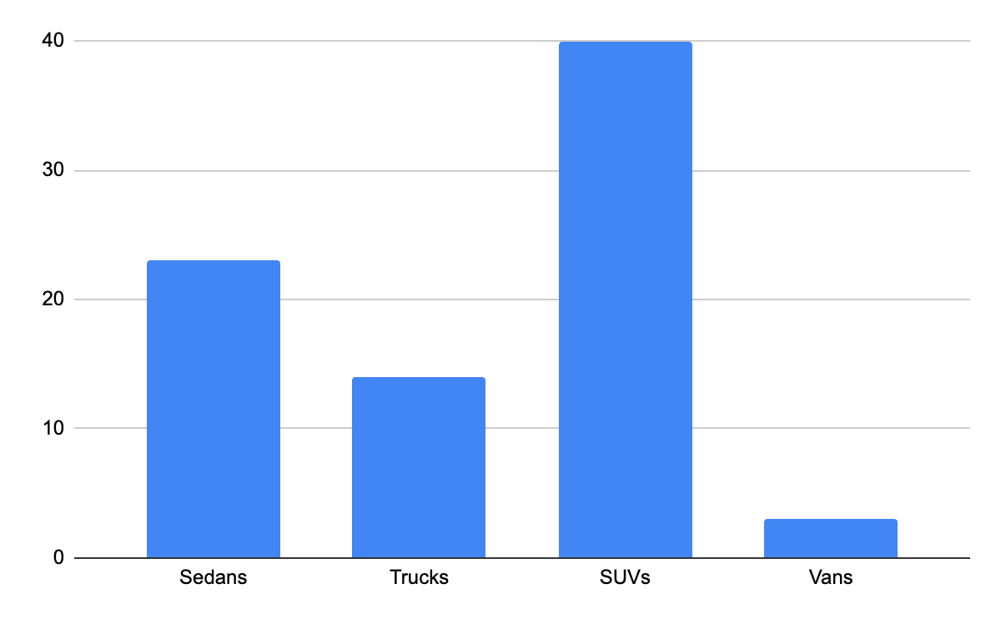
Visualizing Categorical Data: Column Charts
Sedans | 23
Trucks | 14
SUVs | 40
Vans | 3

Slide 10
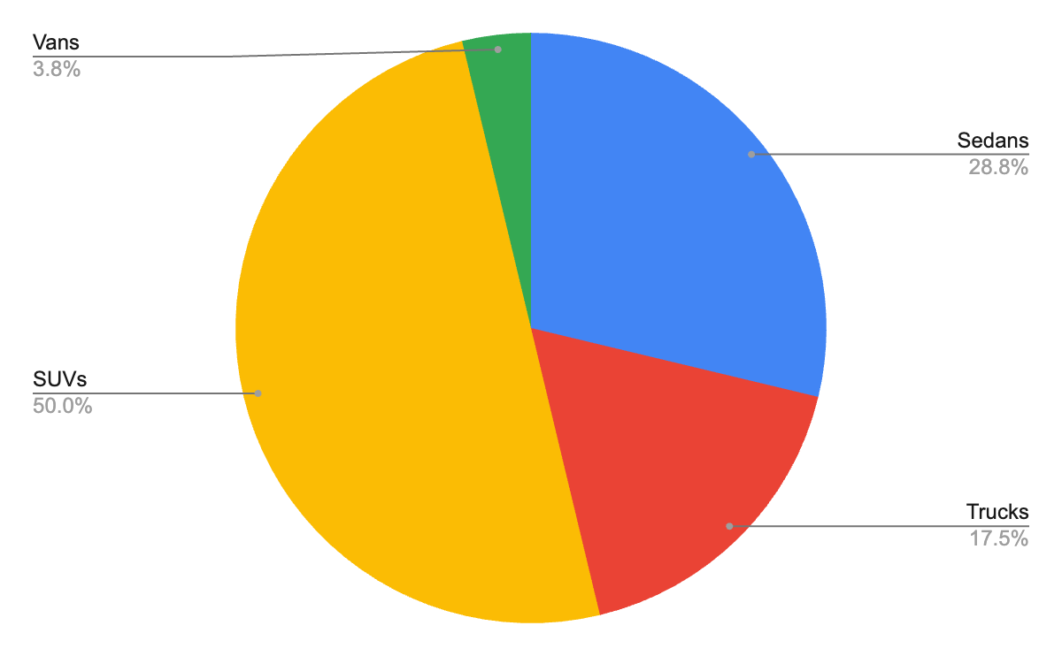
Visualizing Categorical Data: Pie Charts
Sedans | 23
Trucks | 14
SUVs | 40
Vans | 3

Slide 11
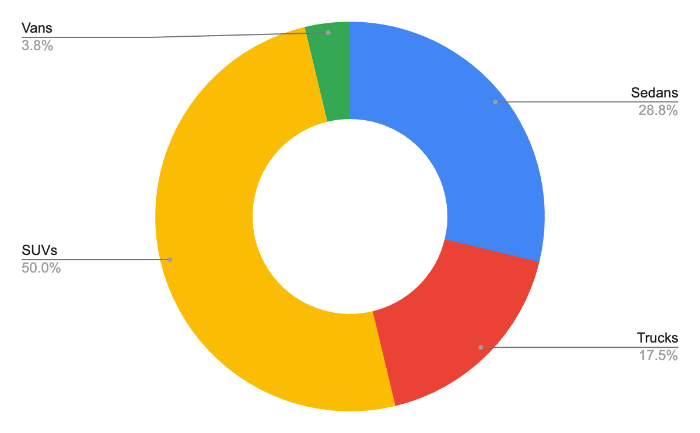
Visualizing Categorical Data: Donut Charts
Sedans | 23
Trucks | 14
SUVs | 40
Vans | 3

Slide 12
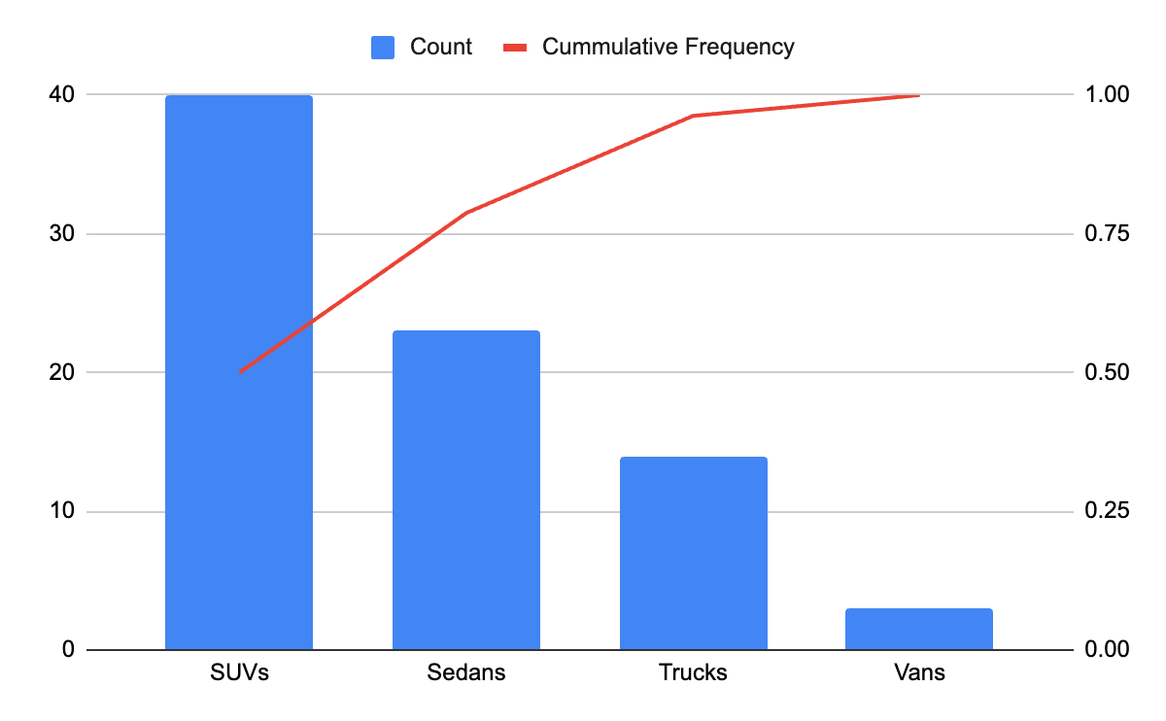
Visualizing Categorical Data: Pareto Charts
Sedans | 23
Trucks | 14
SUVs | 40
Vans | 3

Slide 13
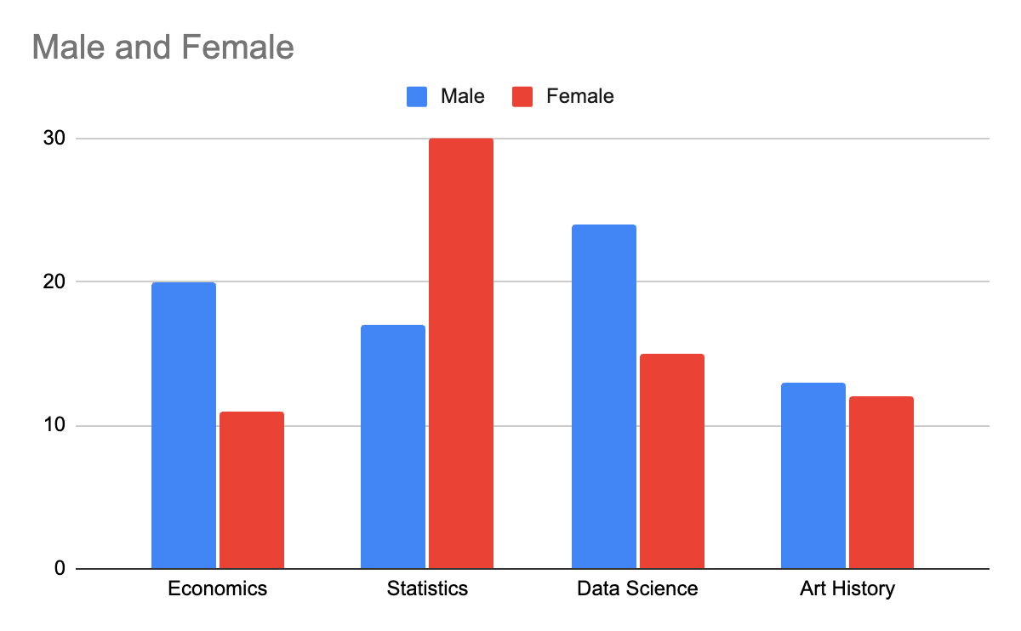
Visualizing Two Categorical Variables: Column Charts
 | Male | Female
Economics | 20 | 11
Statistics | 17 | 30
Data Science | 24 | 15
Art History | 13 | 12

Slide 14
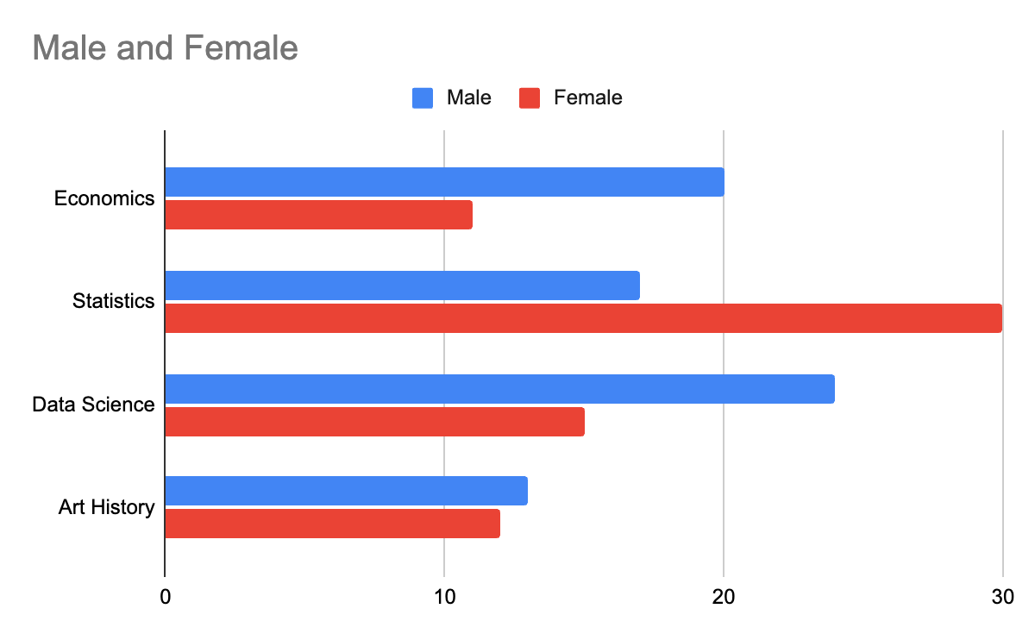
Visualizing Two Categorical Variables: Bar Charts
 | Male | Female
Economics | 20 | 11
Statistics | 17 | 30
Data Science | 24 | 15
Art History | 13 | 12

Slide 15
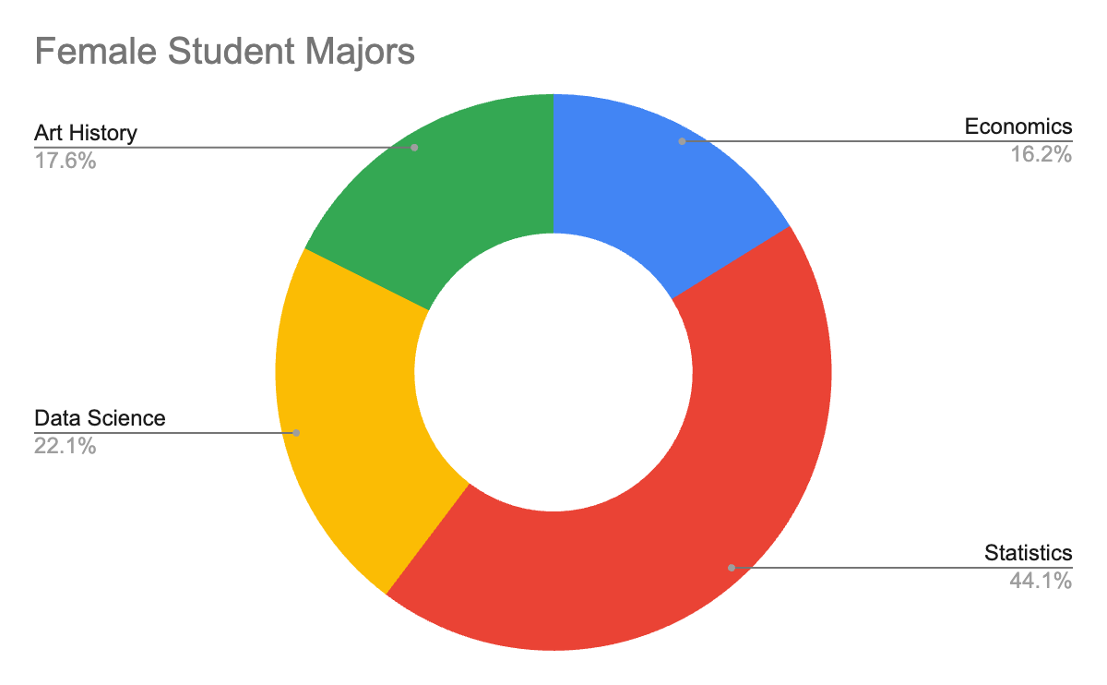
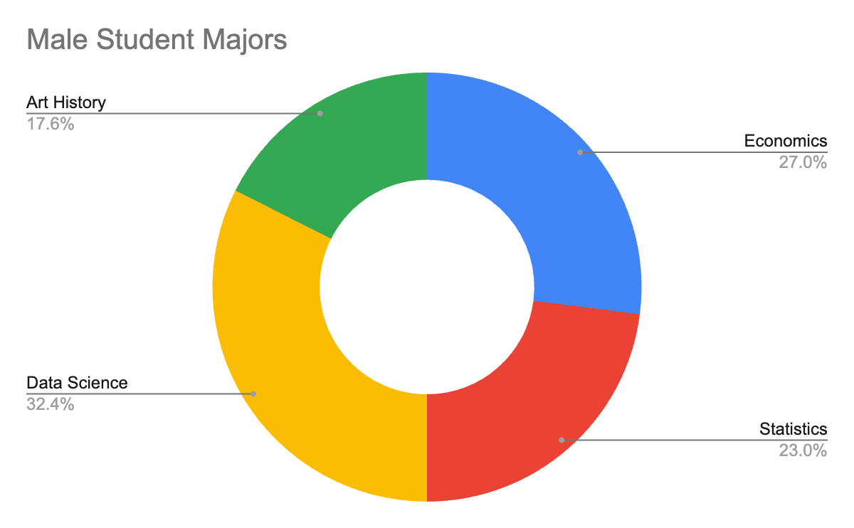
Visualizing Two Categorical Variables: Multiple Donut Charts
 | Male | Female
Economics | 20 | 11
Statistics | 17 | 30
Data Science | 24 | 15
Art History | 13 | 12

Slide 16
Types of Data: Quantitative / Numerical
Discrete or Continuous
Discrete if only using integers (counting numbers) / cannot be subdivided
Usually the resulting of counting
Example: Numbers rolled on dice, Number of students in a class, Number of home runs in a baseball game
Continuous if using numbers that can be meaningfully subdivided into smaller / finer levels
Usually the result of measuring
Example: Time taken during a project, speeds of cars, heights of individual people

Slide 17
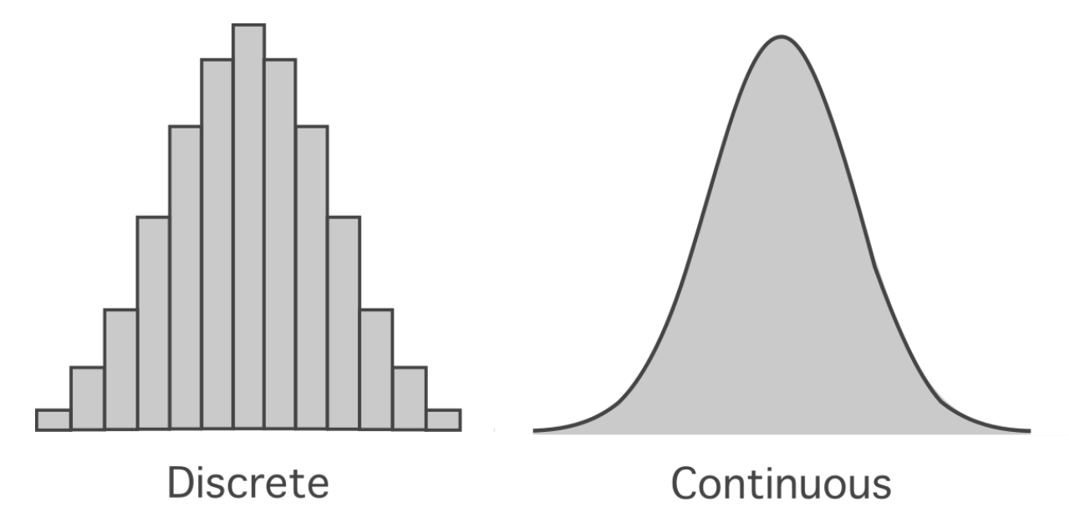
Discrete vs Continuous

Slide 18
Organizing Numerical Data: Stem & Leaf Tables
Exam Grades:
68
65
79
87
92
89
67
81
90
Stem | Leaf
6 | 5 7 8
7 | 9
8 | 1 7
9 | 0

Slide 19
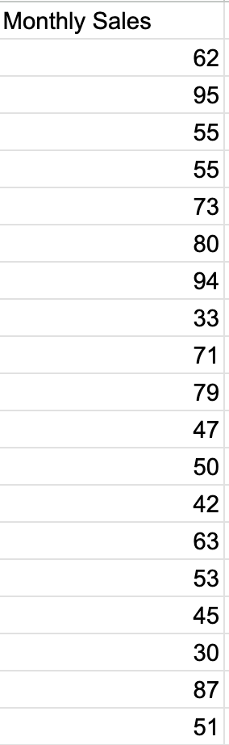
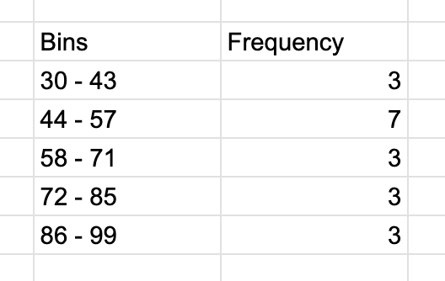
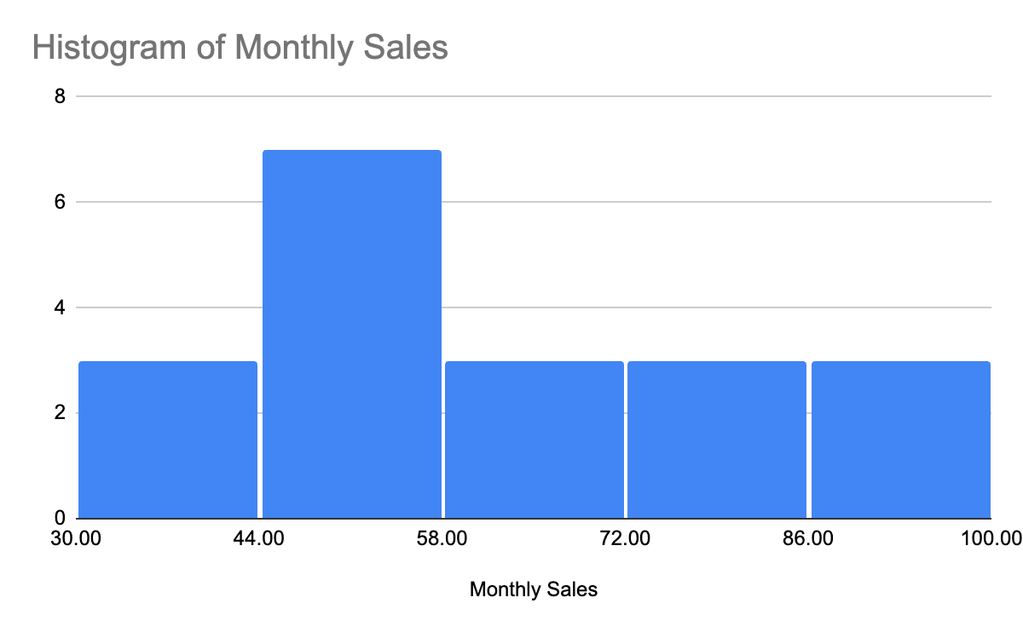
Visualizing Quantitative Data: Histograms
Similar to bar charts
Divide data into “bins” (typically between 5 and 20)
Height based on frequency / percentage of total count
Divide range of data (Max - Min) by bin count to get bin size / width
Example: If max = 95 and min = 30, range = 65. If five bins, bin width = 65/5 = 13
No gaps in bars if data are continuous

Slide 20
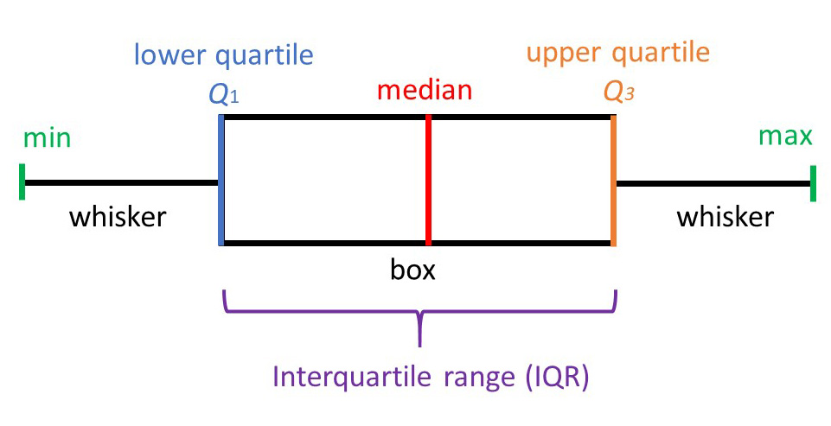
Visualizing Quantitative Data: Box and Whisker Plots

Slide 21
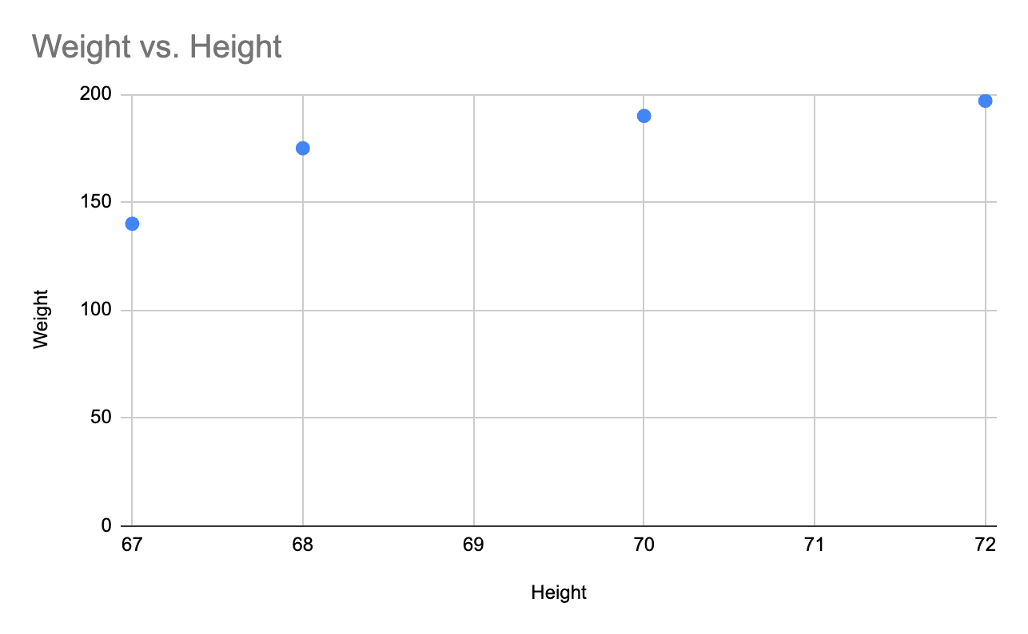
Visualizing Two Numerical Variables: Scatter Plots
Plot coordinate pairs of two variables
Height | Weight
67 | 140
68 | 175
70 | 190
72 | 197

Slide 22
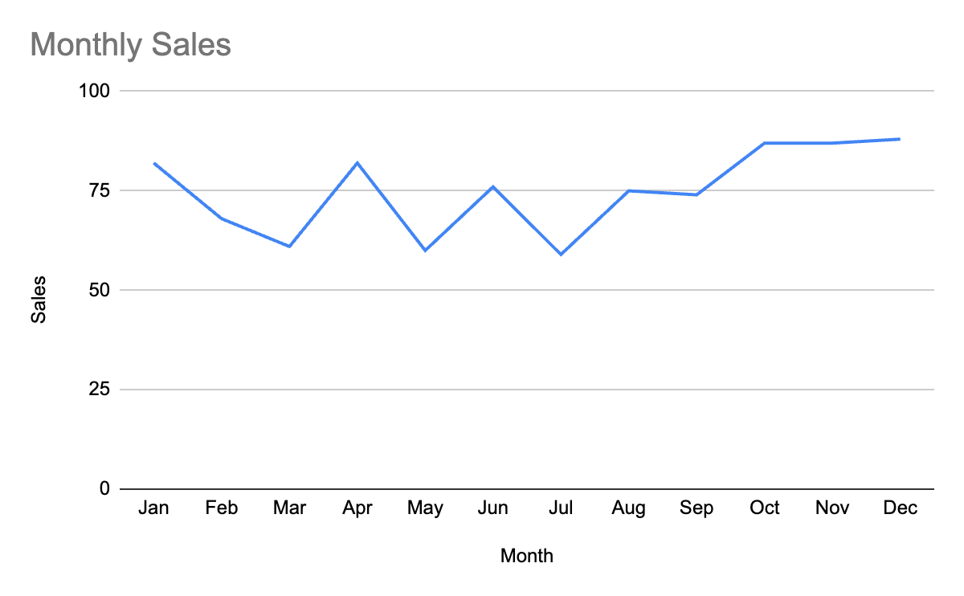
Visualizing Numerical Data - Time Series / Line Charts
Month | Sales
Jan | 82
Feb | 68
Mar | 61
Apr | 82
May | 60
Jun | 76
Jul | 59
Aug | 75
Sep | 74
Oct | 87
Nov | 87
Dec | 88

Slide 23
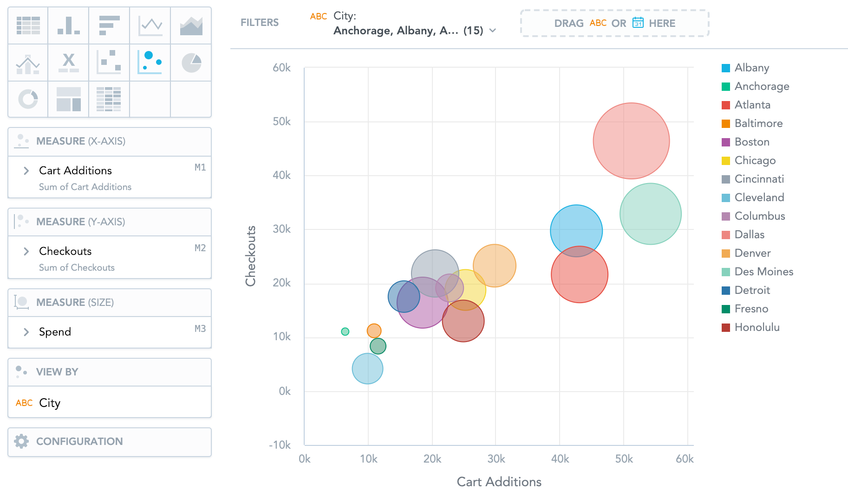
Visualizing Three Or More Variables: Bubble Charts
X and Y values go on the X and Y axes, respectively
A third variable, Z, is related to the size of the bubble
Color of bubbles could indicate another categorical or continuous variable
Remember: Just because you can, doesn’t mean you should…

Slide 24
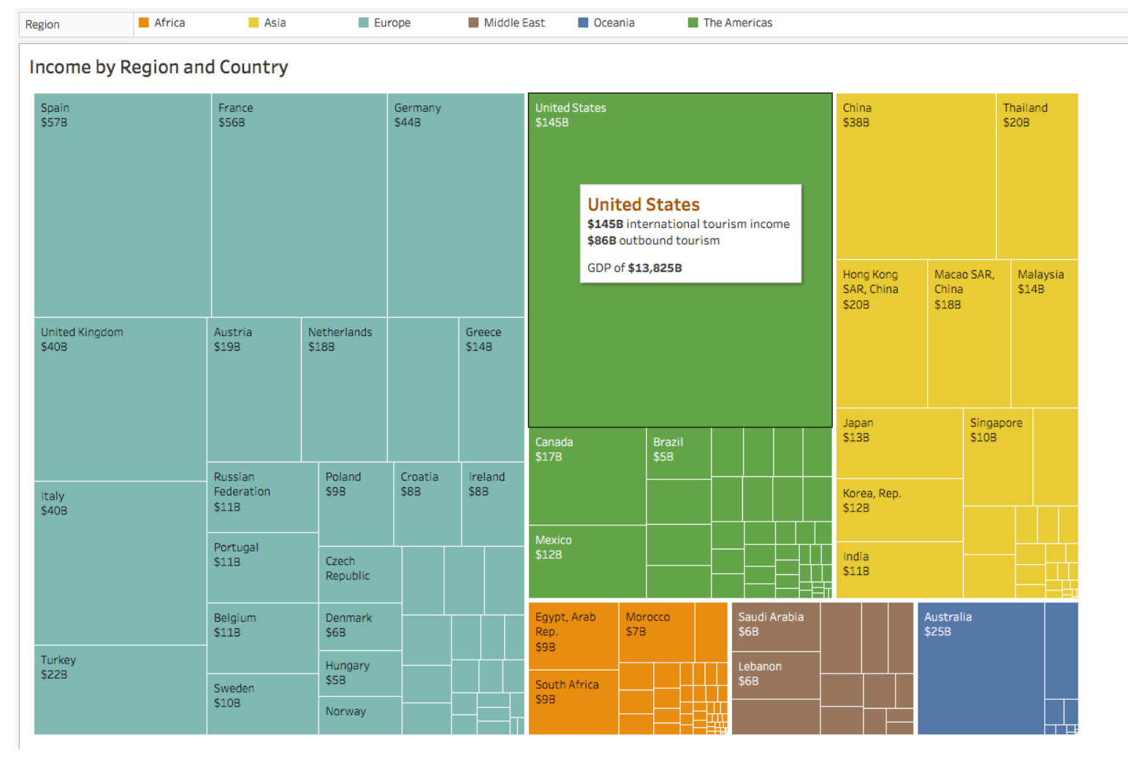
Tree Map
Area of squares shows relative magnitude of each category

Slide 25
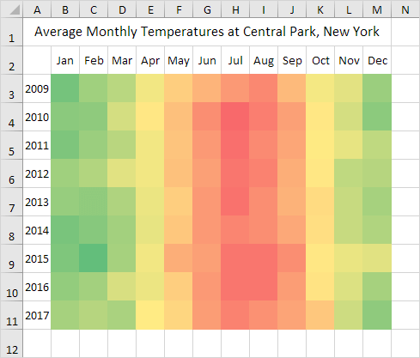
Heat Maps
Color of segment indicates direction and/or magnitude
Can be configured all sorts of ways

Slide 26
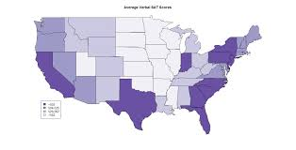
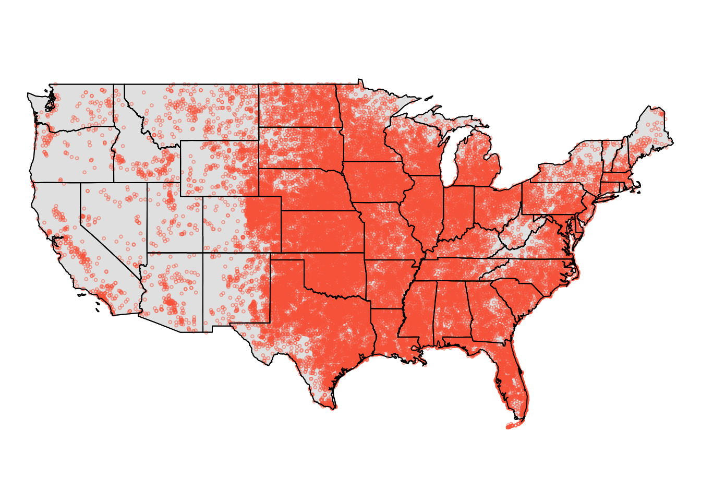
Spatial Data
Spatial data: Data with a location component
Data added to map as labels, points, colors, etc.
Sometimes called “geospatial” or GIS

Slide 27
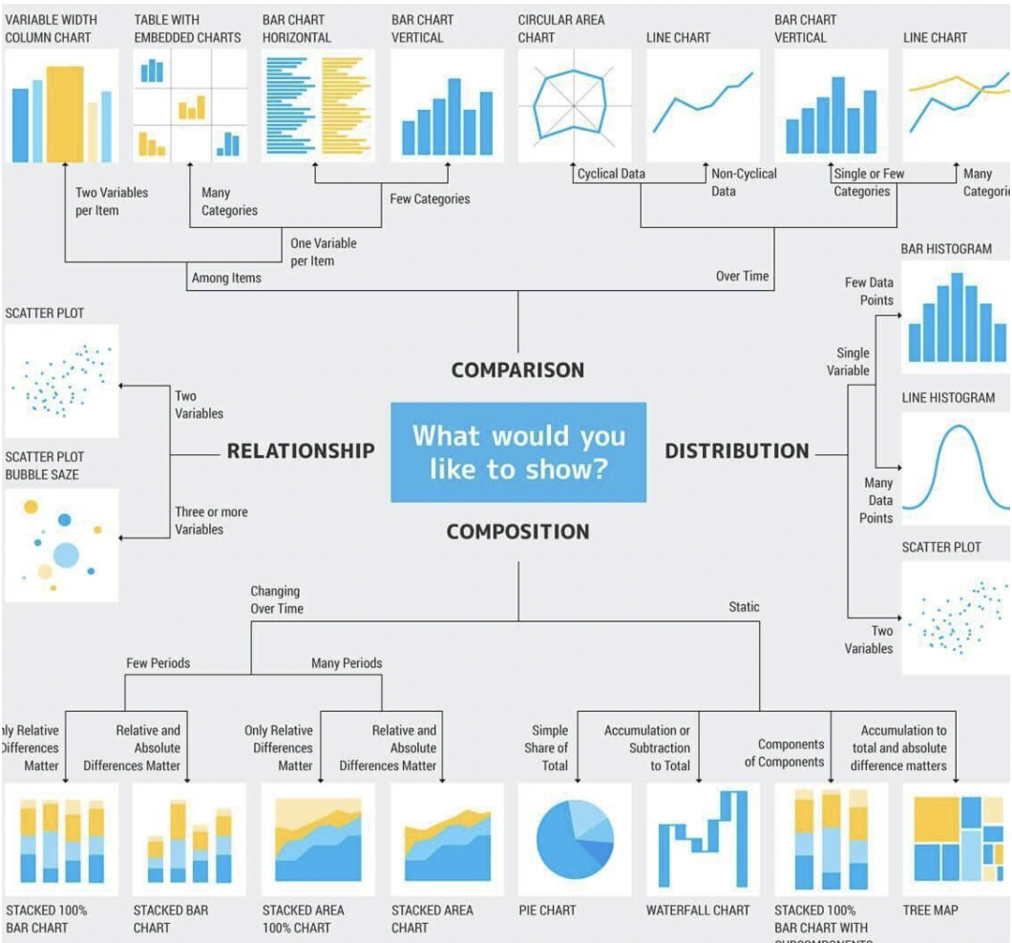

Slide 28
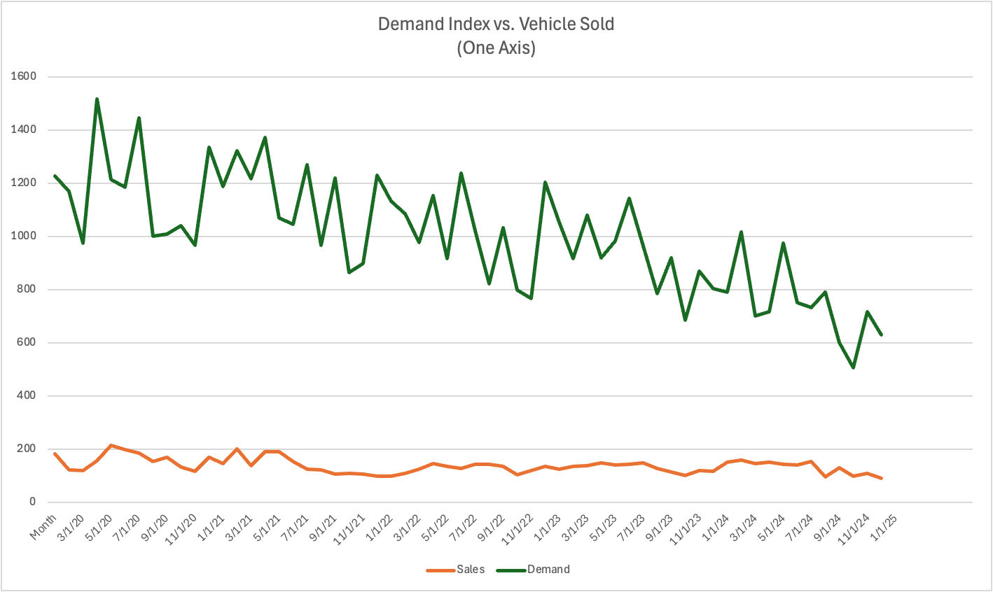
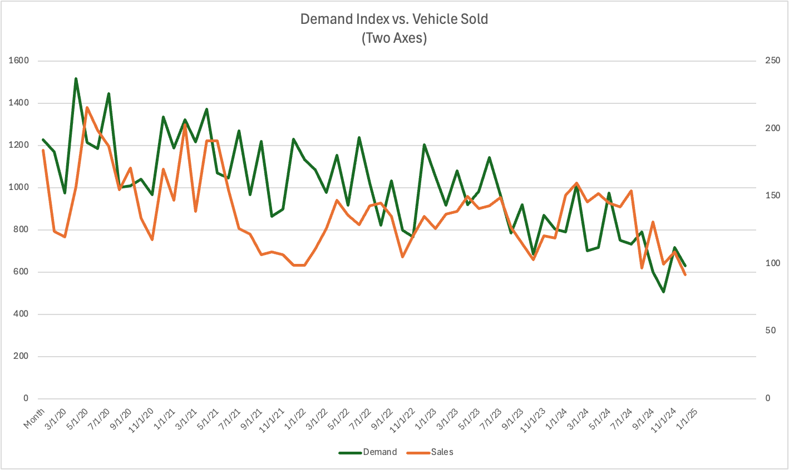
Multiple Axes
When displaying two pieces of data on one chart, use multiple axes if the units aren’t the same

Slide 29
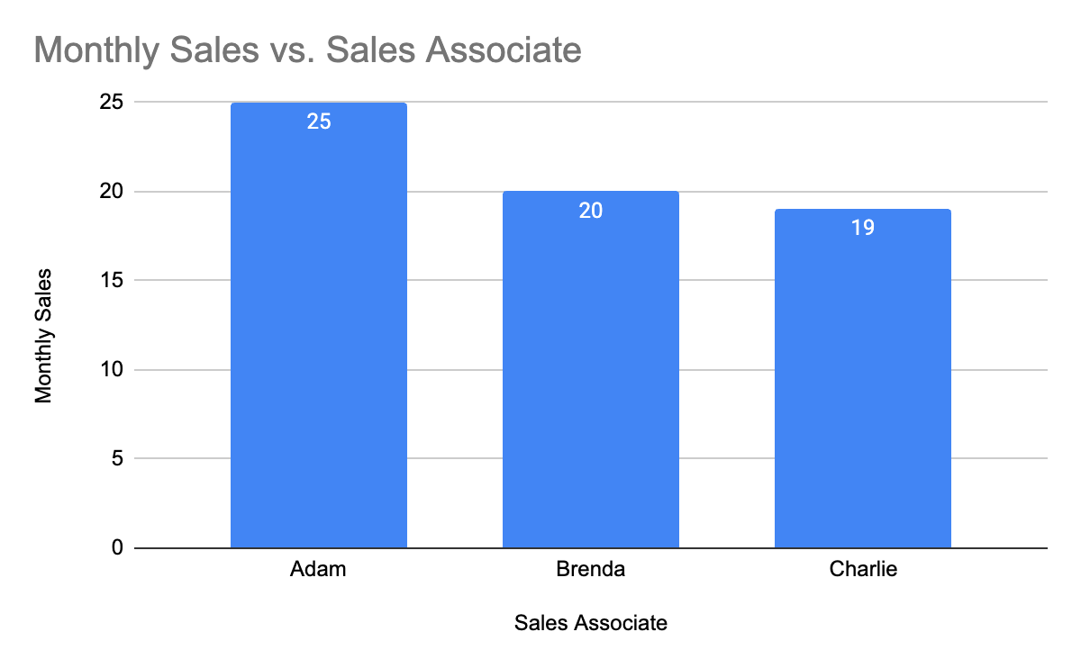
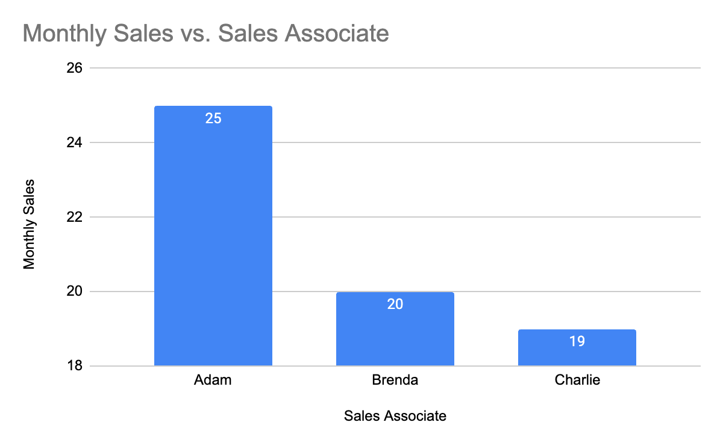
How To Lie With Statistics!
Mess with the axes!

Slide 30
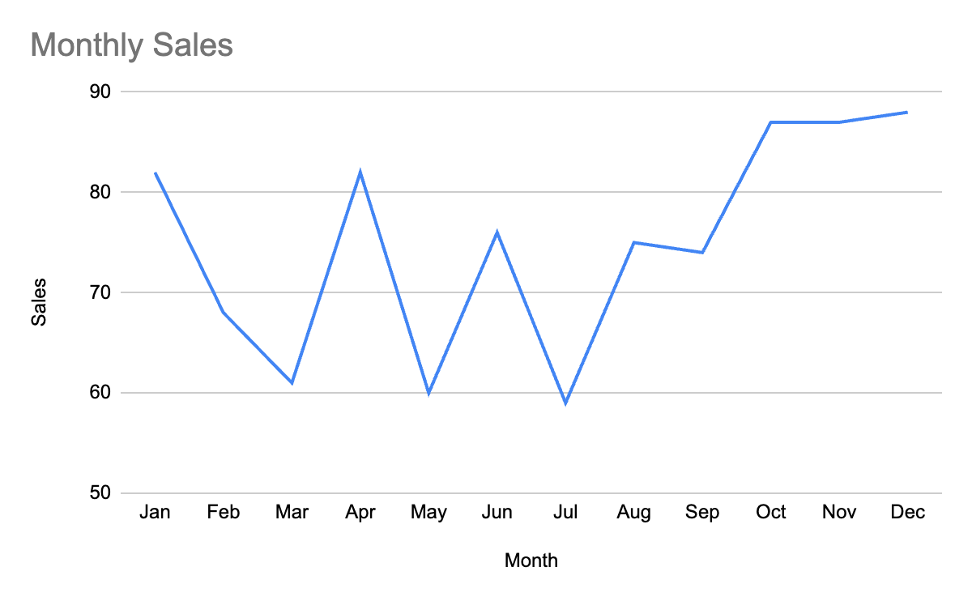
How To Lie With Statistics!
Mess with the axes!

Slide 31
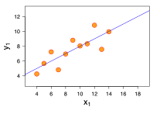
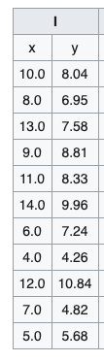
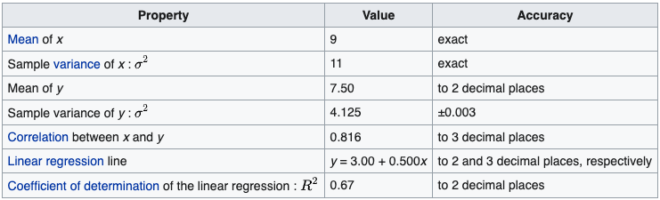
Anscombe's Quartet

Slide 32
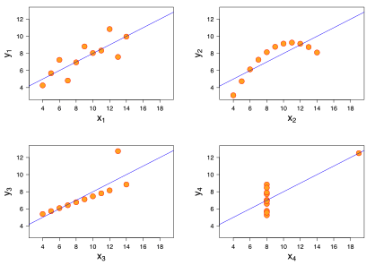

Slide 33
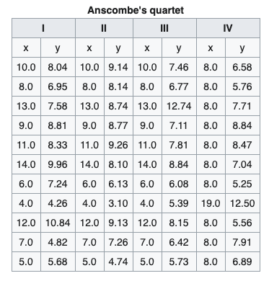
Anscombe's Quartet

Slide 34
Key lesson of Anscombe's Quartet: Visualizing data is a critical part of analysis, not just for fun, aesthetics, and/or showing others!!!

Slide 35
Summary / Visualization Best Practices
Use the simplest method that works to tell the story you’re trying to tell
Label your chart and all axes
Begin the axes at zero
Use a consistent scale for the axes
Avoid 3D charts and other esoteric styles (radar, bubble, cone, etc.)
Avoid clutter and information overload

Slide 36
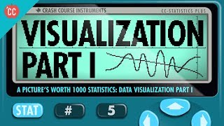

Slide 37
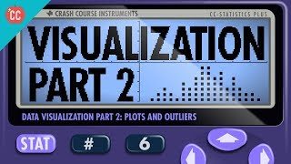

Slide 38
Sampling
Population: All of the items of interest
Examples: All of the students at Webster University, All registered voters
Sample: A subset of the population
Example: Just the students in this room (assuming we’re interested in all of the students at Webster), 100 registered voters selected at random from the voting rolls

Slide 39
Why Sample?
We collect samples instead of measuring populations because:
It’s easier
It’s faster
It’s cheaper
It’s (more) feasible

Slide 40
Types of Sample - Non Probability
Non Probability Sampling: Items are chosen without regard to their probability of occurrence
Types:
Convenience: Items are selected because they’re easy to sample
Judgment: Items are sampled based on expert / domain knowledge
These are not good ways to sample and risk sampling bias*

Slide 41
Sampling Bias
Sampling bias occurs when the sample selected for a study is not representative of the population, leading to inaccurate or misleading conclusions.
Types:
Selection Bias: Occurs when certain groups of the population are systematically more or less likely to be included in the sample. Example: Conducting a phone survey but only calling landlines, which excludes younger people who primarily use mobile phones.
Undercoverage Bias: Happens when some members of the population have no chance of being included in the sample. Example: A political poll that only surveys registered voters, ignoring eligible but unregistered voters.
Nonresponse Bias: Occurs when a significant portion of selected respondents do not participate, and those who do respond differ in a meaningful way from those who don't. Example: A survey about income levels where wealthier individuals are less likely to disclose their earnings.

Slide 42
Sampling Bias (Continued)
Types:
Voluntary Response Bias: Happens when individuals self-select into the study, meaning only those with strong opinions tend to participate. Example: An online poll about customer satisfaction where only dissatisfied customers respond.
Survivorship Bias: Occurs when only subjects that have “survived” or persisted are included in the sample, leading to misleading conclusions. Example: Studying the success of businesses by analyzing only those that still exist, ignoring failed businesses.
Convenience Sampling Bias:Happens when researchers choose a sample that is easy to access rather than one that is representative. Example: A study on college student habits that only surveys students at one university.
Healthy User Bias:Occurs when participants in a study are healthier than the general population, often affecting medical research. Example: A study on the benefits of exercise that surveys only gym-goers, who are likely to be healthier than average.
Exclusion Bias: Happens when certain groups are unintentionally left out due to study design flaws. Example: A medical trial that excludes pregnant women, leading to results that don't generalize to the entire population.

Slide 43
Types of Sample - Probability
Probability Sampling: Sampling based on known probabilities
Types:
Simple Probability
Systematic
Stratified
Cluster

Slide 44
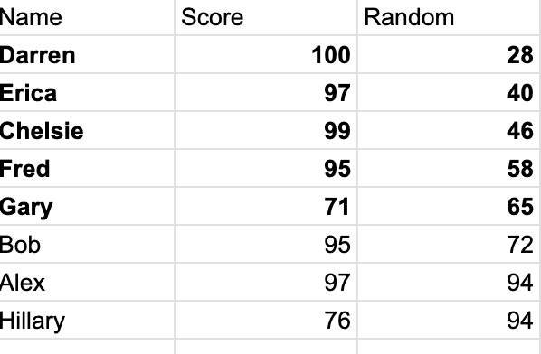
Simple Probability Sampling
Each item in the sample has an equal probability of occurrence / selection.
Sampling frame: The list of all items in the population
Steps:
Assign Each item a number randomly (using an unbiased and systematic source, like a computer, not your intuition)
The sampling frame by the column of random numbers
Select the top n number of items, where n is the number of items required to meet the significance threshold of your study

Slide 45
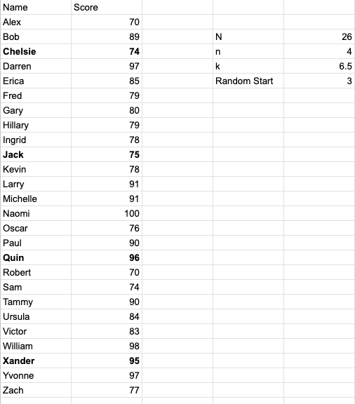
Systematic Probability Sampling
Steps:
Divide population/frame into k segments, where k = N/n
Select a starting point randomly from the first segment, then sample every k’th element

Slide 46
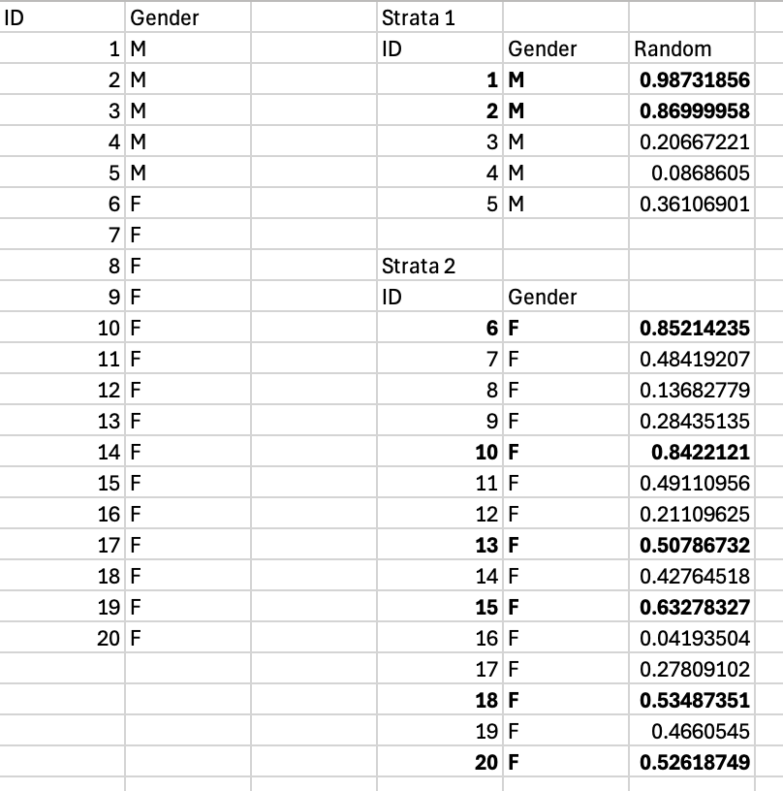
Stratified Sampling
Steps:
Divide population/frame into subgroups, called strata, based on common attributes
Randomly sample from the strata (largest random number used)
Combine the samples
Can be proportionate to the population or not - Since 3/4 of the population is female, 3/4 of the sample should come from the female strata
Can also be disproportionate and evenly sampled from each strata, but this is potentially biasing

Slide 47
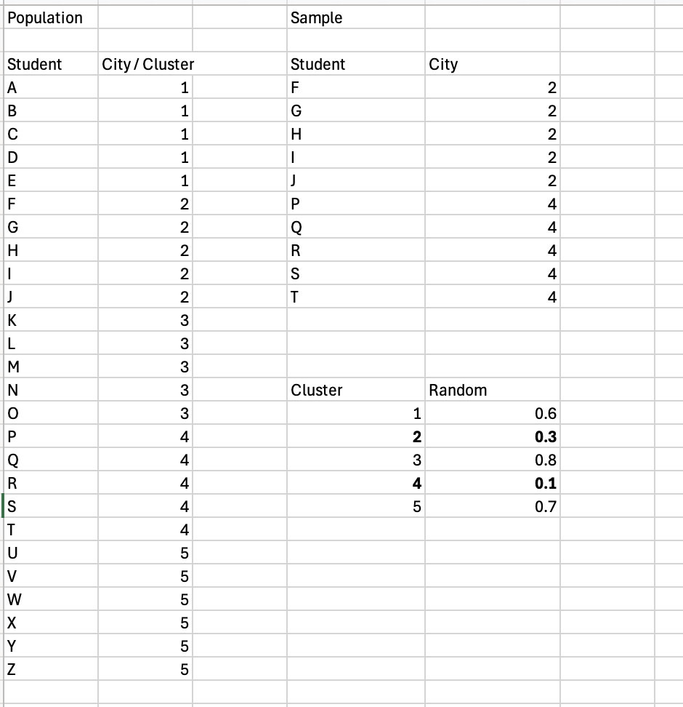
Cluster Sampling
Steps:
Divide population into clusters based on some relevant attribute
Each cluster should be representative of the whole population
Randomly select clusters
Use all observations from each cluster to calculate statistics

Slide 48
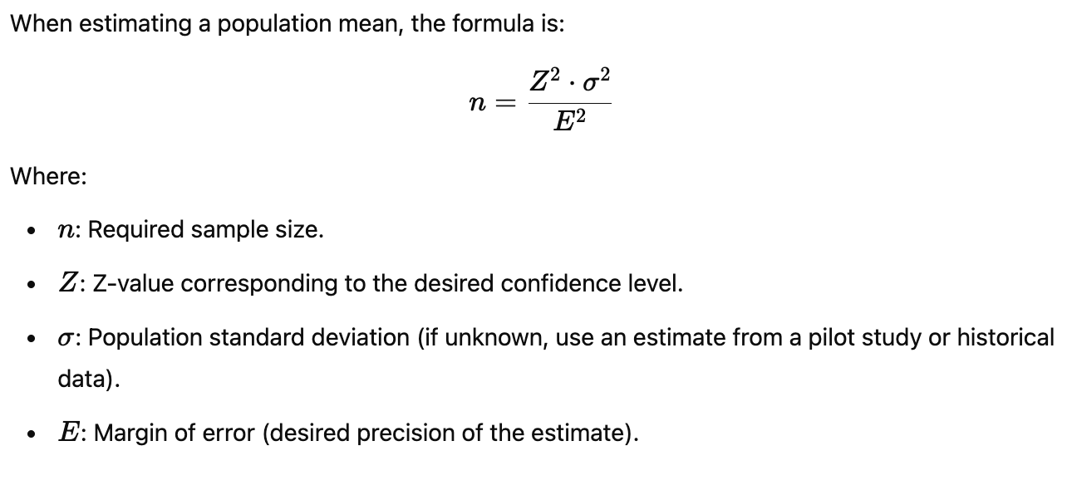
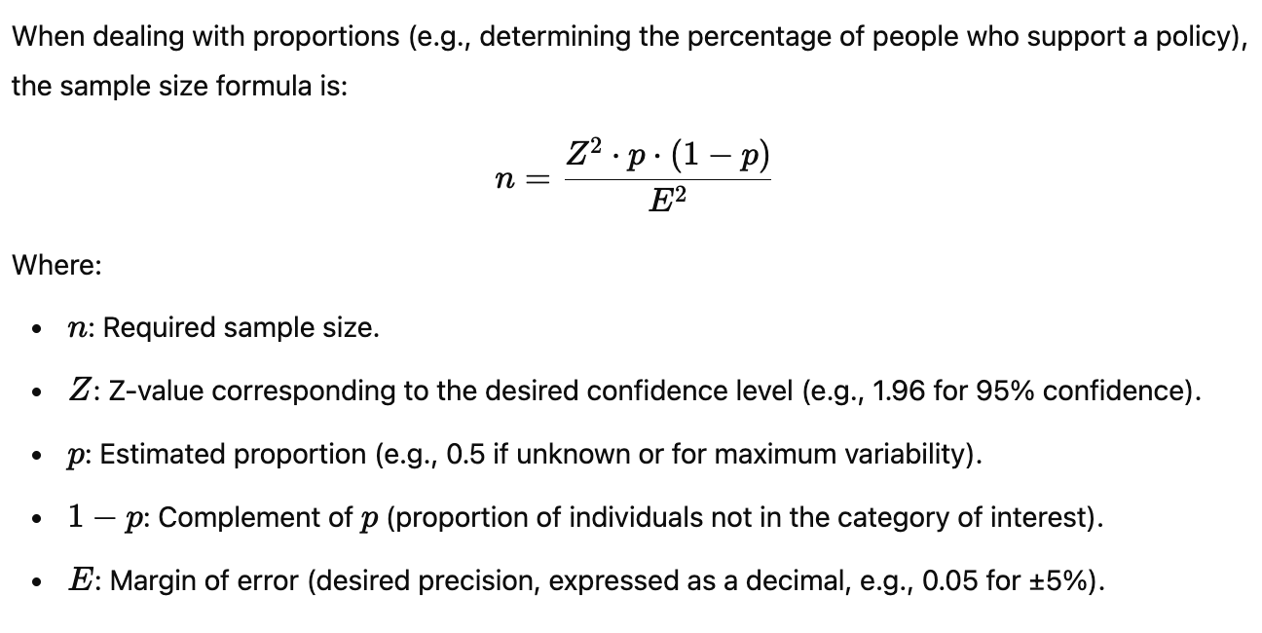
Necessary Sample Size*
*We’ll revisit this later

Slide 49
Necessary Sample Size Example - Means
Z for
90% = 1.65
95% = 1.96
99% = 2.33
E = Margin of Error = +/- Point estimate
How many apples needed to be 95% confident in your estimate of the mean, with a margin of error of +/- 0.5 oz, given a standard deviation (estimated) of 2 oz.
n = (Z^2 * stdev^2) / E^2
…Math…
n = 61.4656, which we round up to 62
Notes:
Different than for proportions

Slide 50
So, what exactly is a statistic?
When a number is used to summarize an aspect of a population, it is called a parameter.
When a number is used to summarize an aspect of a sample, it is called a statistic.

